Slide 1
CS-2001 Data Structures
Week 3 & 4 | Lecture 8-12

Slide 2
Topics
Array Vs Linked list
Single Linked List
Doubly Linked List
Circular Linked List
Doubly Circular Link List

Slide 3
Array Vs Link list
What are the differences between array and linked list?
What are the advantages and disadvantages of one data structure over the other?
What is the time complexity of the different operations (such as accessing an element, inserting, removing, and determining the size)?
When should you use which data structure?

Slide 4
Array Vs Link list - Representation
An array is a contiguous block of memory that directly contains the data elements.
A linked list consists of list nodes, each containing a data element and a reference to the next node (and – in the case of a doubly linked list – to the previous node)
121 | 34 | 55 | 54 | 12 | 88 | 89 | 50 | 36 | 110
K | V
K | V
K | V
K | V
K | V
K | V

Slide 5
Array vs. Linked List - Time Complexity
Accessing a Specific Element
Operation | Array | Linked List
Accessing the n^{th} element: | O(1) | O(n)
Inserting an element: | O(n) | O(1)
Removing an element: | O(n) | O(1)
Determining the size: | O(1) | O(n)

Slide 6
Array vs. Linked List – Memory Consumption
In an array, each field requires as much memory as the data type it contains. For example, an array of int primitives requires 4 bytes per entry.
In a linked list, we must store both the data element and references to each node’s successor (and possibly predecessor) nodes.
If we stay with the int primitives and assume 4 bytes per reference, we reach 8 bytes per element for a singly linked list.
In summary: for the same length, a linked list requires at least twice as much memory as an array
2 | 4 | 5 | 9
4B | 4B | 4B | 4B
K | V
K | V
K | V
K | V
K | V
K | V
4 | 4
4 | 4
4 | 4
4 | 4
4 | 4
4 | 4
Language | Array | Singly linked list | Doubly linked list
C/C++: | 4 bytes | 8 bytes | 12 bytes

Slide 7
Array vs. Linked List – Locality
Since the memory for an array is allocated in one piece, its elements are located at consecutive memory addresses. When accessing main memory, all array elements on the same memory page are loaded into the CPU cache simultaneously. Thus, once we have accessed one array element, we can access the neighboring elements very quickly.
The nodes of a linked list, in contrast, are allocated at arbitrary locations in memory, i.e., they can be distributed over the entire memory. When traversing a linked list, a new memory page would have to be loaded for each element in the worst case.

Slide 8
Advantages of Linked List over Array
Elements can be inserted and removed with constant time.
A linked list does not occupy any unused memory.

Slide 9
Advantages of Array over Linked List
We can access any array element ("random access") in constant time.
We can traverse an array from back to front – this is not possible with a singly linked list, only with a doubly linked one.
When containing the same number of elements, an array occupies significantly less memory than a linked.
Due to the principle of locality, we can access elements close to each other much faster in an array.
The garbage collector can perform a reachability analysis much quicker on an array than on a linked list.
Deleting an array frees a contiguous memory area, while deleting a linked list leaves fragmented memory.

Slide 10
Array vs. Linked List – Conclusion
If elements are often inserted or removed in the middle of the data structure, then a linked list should be the better choice.
For all other use cases, array-based data structures generally deliver better performance and a better memory footprint and should therefore be preferred.

Slide 11
Linked List
A Linked List is a sequence of elements such that each element in the linked list points to the adjacent element in the sequence.
Each element of the Linked List is called a Node. A Linked List is formed by connecting multiple nodes.
A node consists of two parts,
Data
Pointer to another node
Data | Ptr
Data | Ptr
Data | Ptr
Data | Ptr

Slide 12
Linked List
Data
Data is the actual raw information that you want to maintain. It can be a video object, a number, a character, etc.
2. Pointer
Pointer stores the link of the adjacent node. Only after reading the reference, we can know the location of the next sequential node.

Slide 13
singly linked list
A Singly Linked List is a specialized case of a generic linked list. In a singly linked list, each node links to only the next node in the sequence.
The first and last node of a linked list usually are called the head and tail of the list, respectively. Thus, we can traverse the list starting at the head and ending at the tail. The tail node is a special node, where the next pointer is always pointing or linking to a null reference, indicating the end of the list.

Slide 14
singly linked list
A linked list is a data structure that has the following properties:
Successive elements are connected by pointers
The last element points to NULL
Can be made just as long as required (until systems memory exhausts)
Does not waste memory space (but takes some extra memory for pointers). It allocates memory as list grows.

Slide 15
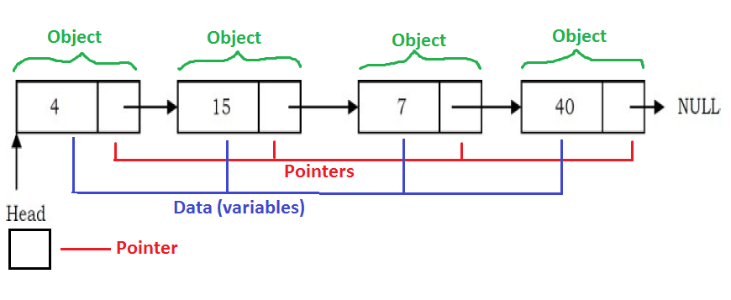
Linked List

Slide 16
Singly Linked List
Generally “linked list” means a singly linked list
This list consists of a number of nodes in which each node has a next pointer to the following element
The link of the last node in the list is NULL, which indicates the end of the list

Slide 17
Doubly Link List
Doubly Linked List is a Data Structure, which is a variation of the Linked List, in which the transversal is possible in both the directions, forward and backward easily as compared to the Singly Linked List, or which is also simply called as a Linked List.
Each Doubly Linked List Element contains pointers to next and Previous Elements and the data field.
The First Element will have its Previous pointer as Null, to mark the start of the List.
The Last Element will have its Next pointer as Null, to mark the end of the List.

Slide 18
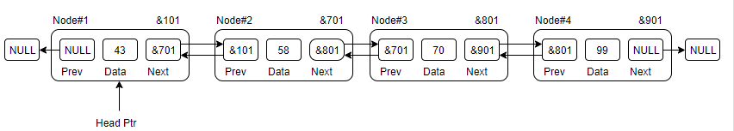
Doubly Link List
Link − each link of a linked list can store a data called an element.
Next − each link of a linked list contains a link to the next link called Next.
Previous − each link of a linked list contains a link to the previous link called previous
As we have seen, the doubly linked list is a variation of the linked list, where we can transverse in both directions using an extra pointer “previous”.
Since it as an extra pointer, it has some downsides like:
It takes extra memory to store this extra pointer, over the Singly Linked list.
Every operation(insert/delete etc.) has an extra overhead of managing the previous pointer as well.

Slide 19
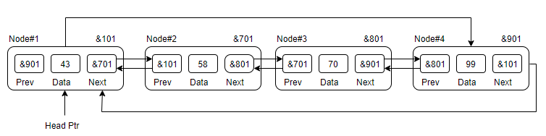
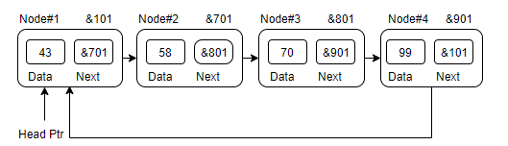
Circular Link List
In circular double linked list, the next pointer of the last node points to the first node and the previous pointer of the first node points to the last node making the circular in both directions.
The last link's next points to the first link of the list in both cases of singly as well as doubly linked list.
The first link's previous points to the last of the list in case of doubly linked list.
Doubly Linked List as Circular
Singly Linked List as Circular

Slide 20
Basic Operations
Traversing the list
Inserting an item in the list
Insertion at beginning
Insertion at end of the list
Insertion after specified node
Deleting an item from the list
Deletion at beginning
Deletion at the end of the list
Deletion after specified node
Searching

Slide 21
Time Complexity – Best
Data structure | Access | Search | Insertion | Deletion
Array | O(1) | O(1) | O(1) | O(1)
Singly Linked list | O(1) | O(1) | O(1) | O(1)
Doubly Linked List | O(1) | O(1) | O(1) | O(1)
Circular Linked | O(1) | O(1) | O(1) | O(1)

Slide 22
Time Complexity – Worst
Data structure | Access | Search | Insertion | Deletion
Array | O(1) | O(N) | O(N) | O(N)
Singly Linked list | O(N) | O(N) | O(1) | O(1)
Doubly Linked List | O(N) | O(N) | O(1) | O(1)
Circular Linked | O(N) | O(N) | O(1) | O(1)

